Slide 1


Multiple and polynomial regression Lesson 3 by Anna Levant

Slide 2
Purpose of Regression Analysis
The dependent features are called the dependent variables, outputs, or responses.
The independent features are called the independent variables, inputs, or predictors.
Regression analysis is used primarily to
predicts the value of a dependent variable based on the value of at least one independent variable
answer whether and how some phenomenon influences the other or how several variables are related

Slide 3
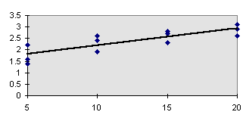
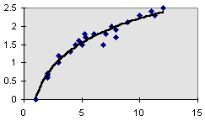
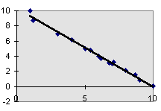
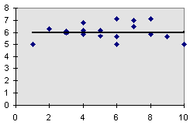
Types of Regression Models
Positive Linear Relationship
Relationship NOT Linear
Negative Linear Relationship
No Relationship

Slide 4




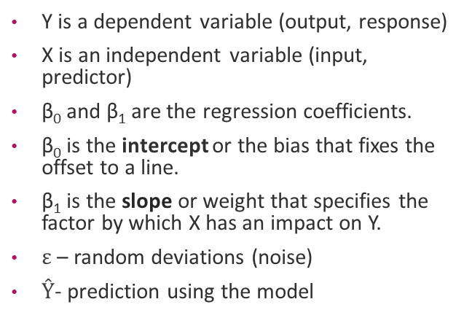
Recall: Simple Linear Regression
$$Y_{i}=β_{0}+β_{1}X_{i}+ε_{i}$$
Y is a dependent variable (output, response)
X is an independent variable (input, predictor)
β₀ and β₁ are the regression coefficients.
β₀ is the intercept or the bias that fixes the offset to a line.
β₁ is the slope or weight that specifies the factor by which X has an impact on Y.
$ε$ – random deviations (noise)
$Ŷ$- prediction using the model
Y
$$ε_{i}$$
$${\hat{Y}}_{i}=β_{0}+β_{1}X_{i}$$
X
Observed Value
$$Ŷ=β_{0}+β_{1}X$$

Slide 5
Multiple Linear Regression
Of course, you'd always want as much data about a person as possible. Even though height and favorite number may not be strongly related, at worst you could just ignore the information on favorite number. We want our models to be able to take in lots of data as they make their predictions
If you must guess someone's height, would you rather be told
Their weight, only
Their weight and gender
Their weight, gender, and income
Their weight, gender, income, and favorite number
Multiple or multivariate linear regression is a case of linear regression with two or more independent variables.
Notes:
Of course, you'd always want as much data about a person as possible. Even though height and favorite number may not be strongly related, at worst you could just ignore the information on favorite number. We want our models to be able to take in lots of data as they make their predictions

Slide 6

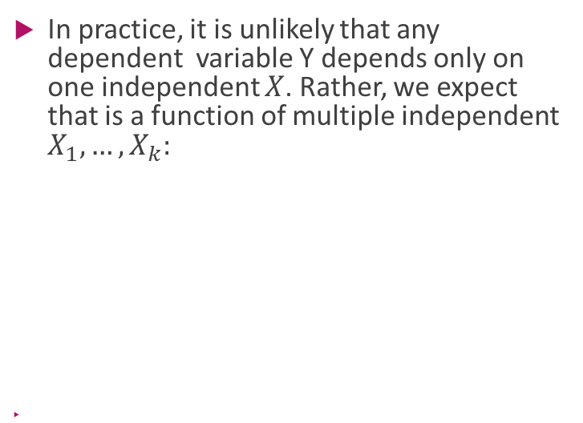

Multilinear Models
In practice, it is unlikely that any dependent variable Y depends only on one independent $X$. Rather, we expect that is a function of multiple independent $X_{1},…,X_{k}:$
$$Y=β_{0}+β_{1}X_{1}+β_{2}X_{2}+⋯+β_{k}X_{k}+ε$$
$$Ŷ=β_{0}+β_{1}X_{1}+β_{2}X_{2}+⋯+β_{k}X_{k}$$
$$Ŷ=β_{0}+β_{1}X_{1}+β_{2}X_{2}$$

Slide 7

Multiple Regression Model: Example
Develop a model for estimating heating oil used for a single-family home in the month of January based on average temperature [in Fahrenheit] and amount of insulation* [in inches].
*Thermal insulation added to buildings for comfort and energy efficiency
Y=
X=

Slide 8
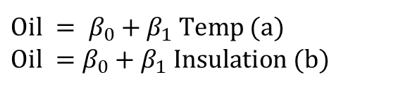
Simple and Multiple Regression Compared: Example
Two simple regressions:
Multiple regression:
Use the same python code for single and multiple regression
-for single regression:
X.shape = [num of observations,1]
-for multiple regression (2 independent variables):
X.shape = [num of observations,2]
from sklearn.linear_model import LinearRegression
lm=LinearRegression()
lm.fit(X, Y)
b0=lm.intercept_
#for single regression
b1=lm.coef_
#for multiple regression (2 independent variables):
b1= lm.coef_[0]
b2= lm.coef_[1]
Yhat = lm.predcit()
$\text{Oil} = β_{0}+β_{1} \text{Temp}$ (a) $$\text{Oil} =β_{0}+β_{1} \text{Insulation}\text{ (}\text{b}\text{)}$$
$$\text{Oil} =β_{0}+β_{1} \text{Temp} +β_{2} \text{Insulation}\text{ (}\text{c}\text{)}$$
Quiz 1: Calculate coefficients for equations a, b and c, compare between them

Slide 9
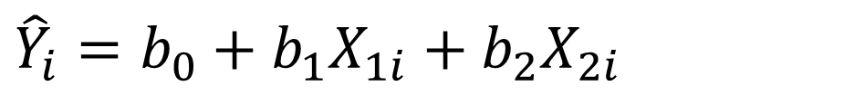
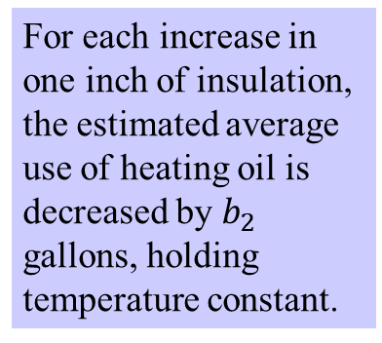
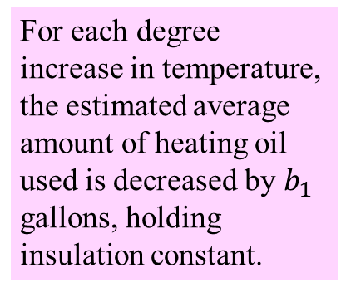
Sample Multiple Regression Equation: Example
$${\hat{Y}}_{i}=b_{0}+b_{1}X_{1i}+b_{2}X_{2i}$$
Quiz 2: Predict the amount of heating oil used for a home if the average temperature is 30 degrees and the insulation is 6 inches using models a,b and c
For each degree increase in temperature, the estimated average amount of heating oil used is decreased by $b_{1}$ gallons, holding insulation constant.
For each increase in one inch of insulation, the estimated average use of heating oil is decreased by $b_{2}$ gallons, holding temperature constant.

Slide 10
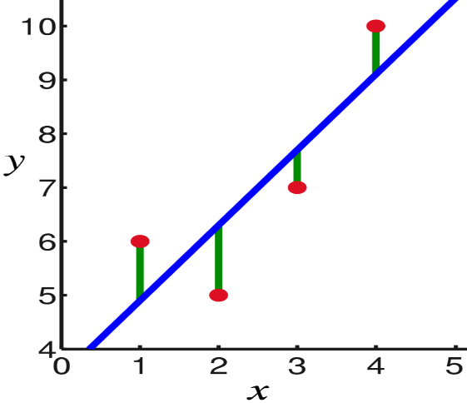

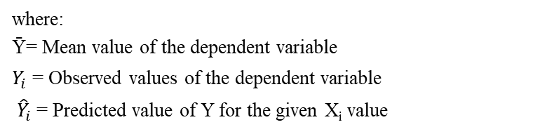

Recall: Measures of Variation
SSE
$$\text{SST} = \text{SSR} + \text{SSE}$$
SSR
Sum of Squares Total
Sum of Squares Regression
Sum of Squares Error
Ȳ
where:
Ȳ= Mean value of the dependent variable
$Y_{i}$= Observed values of the dependent variable
${ \hat{Y}}_{i}$= Predicted value of Y for the given X_{i} value
$R^{2}$ =$1 − \frac{SSE}{SST}=$ $\frac{SSR}{SST}$

Slide 11
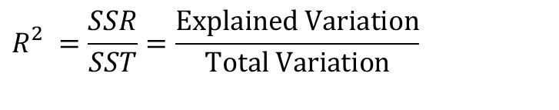
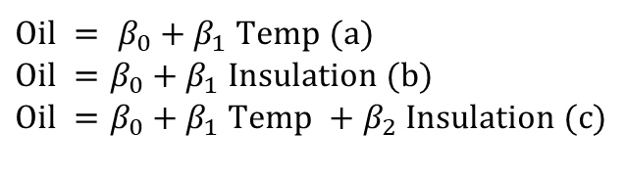
Coefficient of Multiple Determination
Proportion of total variation in Y explained by all X variables taken together
Never decreases when a new X variable is added to model - disadvantage when comparing models
How can we compare which model is better:
$$R_{}^{2}=\frac{SSR}{SST}=\frac{\text{Explained} \text{Variation}}{\text{Total} \text{Variation}}$$
$\text{Oil} = β_{0}+β_{1} \text{Temp}$ (a) $$\text{Oil} =β_{0}+β_{1} \text{Insulation}\text{ (}\text{b}\text{)}$$
$$\text{Oil} =β_{0}+β_{1} \text{Temp} +β_{2} \text{Insulation}\text{ (}\text{c}\text{)}$$

Slide 12
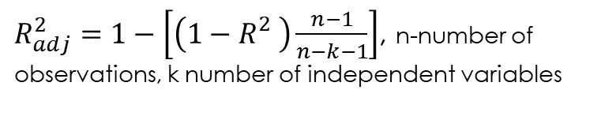
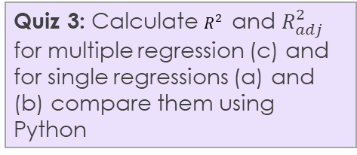

Adjusted Coefficient of Multiple Determination
Quiz 3: Calculate $R_{}^{2}$ and $R_{adj}^{2}$ for multiple regression (c) and for single regressions (a) and (b) compare them using Python
Proportion of variation in Y explained by all X variables adjusted for the number of X variables used
Penalize excessive use of independent variables
Smaller than
Useful in comparing among models
$R_{adj}^{2}=1−\left[\left(1−R_{}^{2}\right)\frac{n−1}{n−k−1}\right]$, n-number of observations, k number of independent variables
$$R_{}^{2}$$
Yhat = lm.predcit()
SS_Residual = sum((y-yhat)**2)
SS_Total = sum((y-np.mean(y))**2)
r_squared = 1 - (float(SS_Residual))/SS_Total
adjusted_r_squared = 1 - (1-r_squared)*(len(y)-1)/(len(y)-X.shape[1]-1)
print r_squared, adjusted_r_squared

Slide 13

Residual Plots: Example
$\text{Oil} = β_{0}+β_{1} \text{Temp}$
Maybe some non-linear relationship
$$\text{Oil} =a_{0}+a_{1} \text{Insulation}$$
No Discernable Pattern – random variations

Slide 14
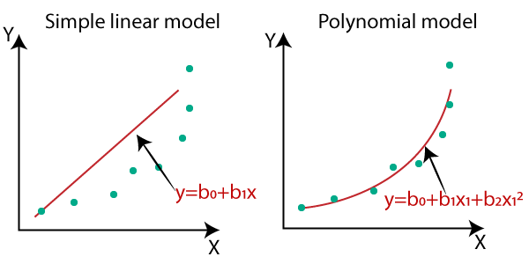
When to use polynomial regression

Slide 15
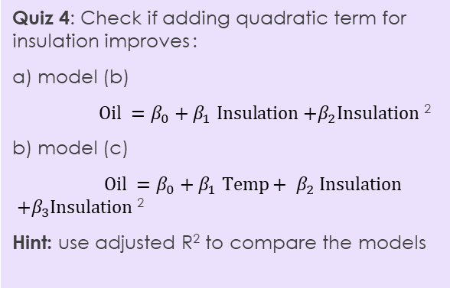
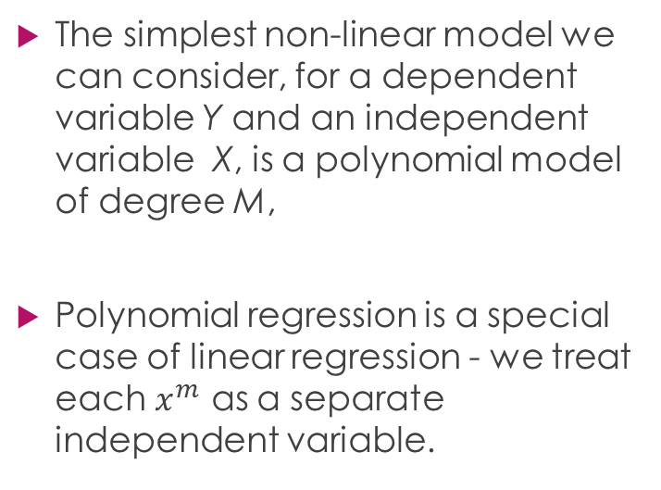
General Polynomial Regression
The simplest non-linear model we can consider, for a dependent variable Y and an independent variable X, is a polynomial model of degree M,
Polynomial regression is a special case of linear regression - we treat each $x^{m}$ as a separate independent variable.
Quiz 4: Check if adding quadratic term for insulation improves :
a) model (b)
$\text{Oil} =β_{0}+β_{1} \text{Insulation}\text{ +}β_{2}\text{Insulation}$²
b) model (c)
$\text{Oil} =β_{0}+{β_{1} \text{Temp}+ β}_{2} \text{Insulation}\text{ +}β_{3}\text{Insulation}$²
Hint: use adjusted R² to compare the models

Slide 16
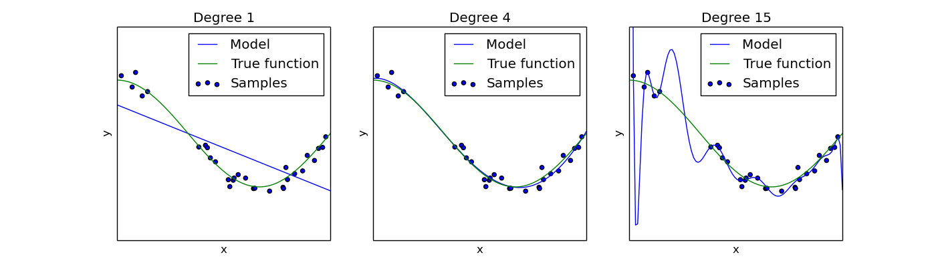
Risk of using polynomial regression of higher order: overfitting vs underfitting
underfitting
overfitting

Slide 17
Overfitting vs underfitting
Overfitting is the phenomenon where the model is unnecessarily complex, in the sense that portions of the model captures the random noise in the observation, rather than the relationship between dependent and independent variable. Overfitting causes the model to lose predictive power on new data
Underfitting occurs when a model is too simple — informed by too few features or regularized too much — which makes it inflexible in learning from the dataset.

Slide 18
So we learned today:
Multiple linear regression
How to evaluate if multiple linear regression is better than simple
Polynomial regression, overfitting risk

Slide 19
Thank you!

